Slide 1


Smart University System
"Solve All Of Your Trouble "
FINAL YEAR PROJECT
Supervisor by:
Uzair Saeed
Submitted by:
Murad Zahid {BSCS-FA19-006}
Bilal Ahmad {BSCS-FA19-033}
Bilal Hafeez {BSCS-FA19-046}

Slide 2
1
Introduction
2
Problem Identification
3
Objective/Scope
4
List of Features
Contents
5
Contents
Methodology
6
GANTT Chart
7
Market Competitors
8
Project Milestone

Slide 3
INTRODUCTION
SUS(Smart University System)
SUS is a web-based system and the set of technological tools that, when applied,improve the way processes and activities are carried out. Implementing it shows several important challenges, such as effective management of material and structural resources in the organization.
Each university requires a general-purpose system that can handle huge amount of data and information.
Similarly, each university requires a smart system that is used in some management activities. Smart University System is a system that uses technological innovations within its organization to accomplish the task.

Slide 4
Literature study / Data collection
SUS(Smart University System)
Problem identification: To develop the Smart University System;
According to the Student Survey Report, the majority student were facing Enrollment issue which is handled manually.
A university student most of the time feels uncomfortable carrying a wallet/cash with him. One can also forget to bring cash on the first hand. One might also worry about theft or loosing cash somewhere.
Date Sheet generation and seating plan for students for exams were handled manually.
Timetable generation is done by using 3rd party software.

Slide 5
OBJECTIVE / SCOPE
SUS(Smart University System)
Improvement in university system.
More flexibility for students and faculty.
Supports data-based decisions.
Offer interaction tools and self-service technology to contribute positively to education.

Slide 6
List of Features
SUS(Smart University System)
Automatic Timetable Generator
Automatic Date Sheet Generator (Seating Plan)
Automated Enrollment System
Billing System Using NFC Card

Slide 7
Methodology
SUS(Smart University System)
Adapted Methodology:
After examining all of the processing models for this System based on their size, complexity, and utility, it was decided to choose “Iterative methodology”.
Why we choose iterative:
Iterative development is a way of breaking down the software development of a large application into smaller chunks. In iterative development, feature code is designed, developed and tested in repeated cycles. With each iteration, additional features can be designed, developed and tested until there is a fully functional software application ready to be deployed to customers.

Slide 8
Tool and Technology
SUS(Smart University System)
Front End:
HTML
CSS
Bootstrap
JavaScript
Back-End:
PHP
Database:
MySQL
IDE:
Visual Studio Code
NFC Card Service:
NFC card reader and writer
NFC cards

Slide 9
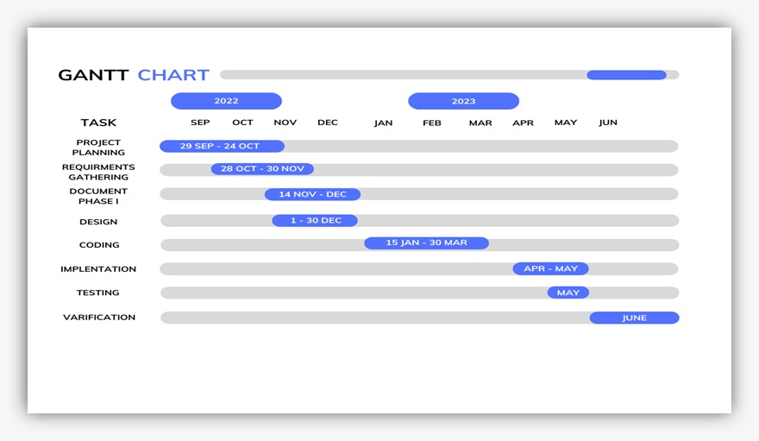
Gantt Chart
SUS(Smart University System)

Slide 10
Market Competitors
SUS(Smart University System)
Review of existing solutions: We compared our project with different universities system such as:
TUF PORTAL
RIPHAH PORTAL
NTU PORTAL
All of the above mention systems are the systems of different universities. The following table shows the comparison according to the features.

Slide 11
Application Name | Enrollment System for Students | Billing System for Students using NFC cards | Timetable Generator for Faculty | Date Sheet Generator for Faculty
TUF Portal | ● | ● | 3rd Party | ●
Riphah Portal | ✔ | ● | 3rd Party | ●
NTU Portal | ✔ | ● | 3rd Party | ●

Slide 12
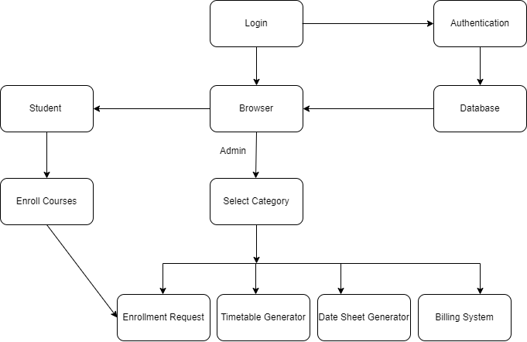
Block diagram
SUS(Smart University System)

Slide 13
List Of Project Milestones
SUS(Smart University System)
Requirement Gathering
Documentation Phase 1
Front End
Database Connection
Remaining Work:
Backend Implementation

Slide 14
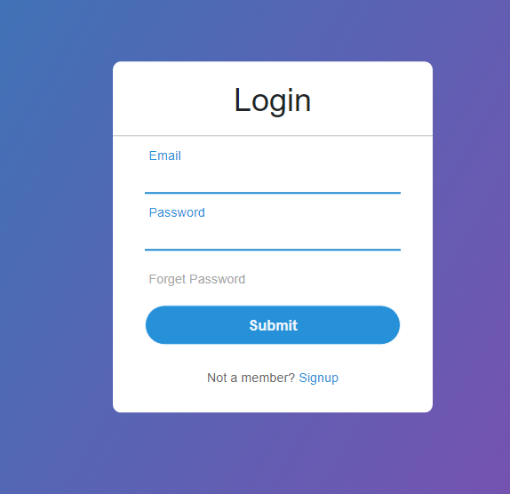
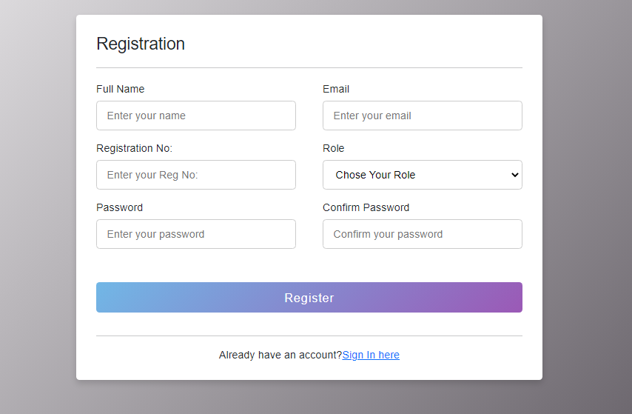
Executed Work Demo (Login/Signup)
SUS(Smart University System)

Slide 15
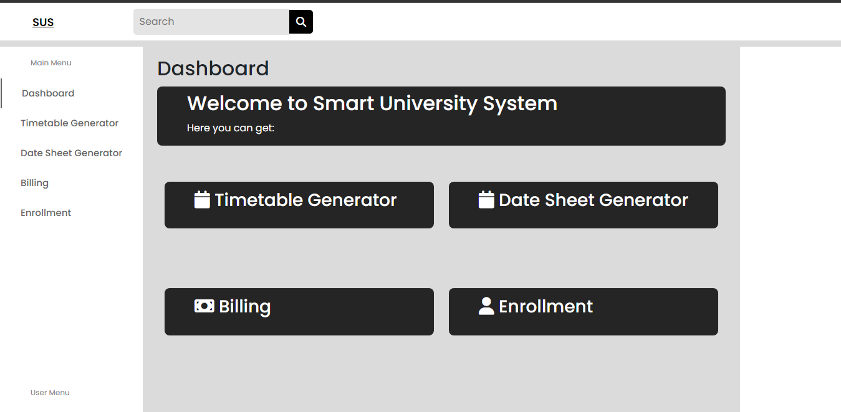
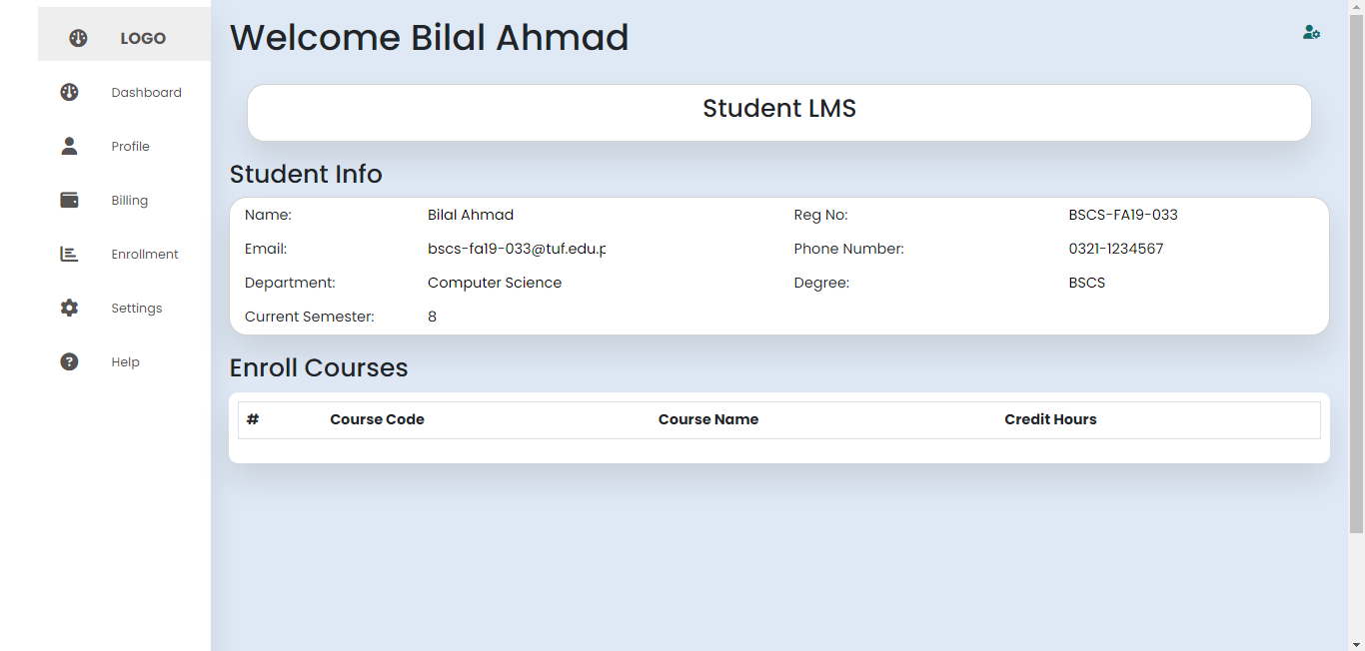
Executed Work Demo (dashboard)
SUS(Smart University System)

Slide 16
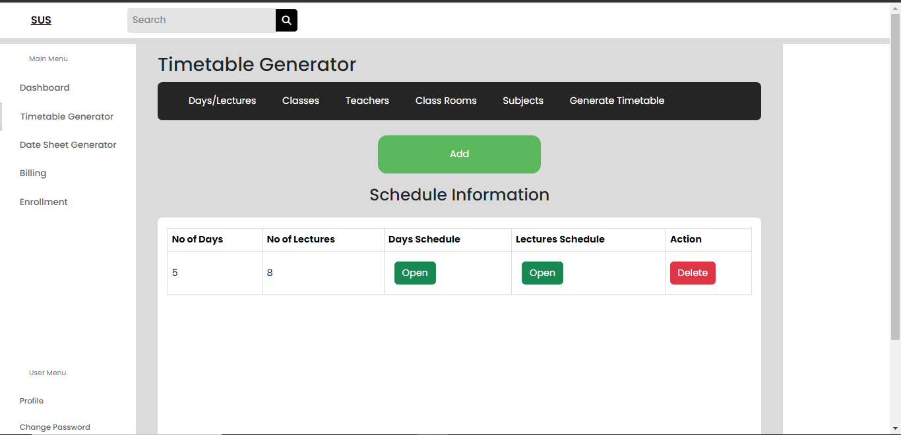
Timetable Generator Form
SUS(Smart University System)

Slide 17
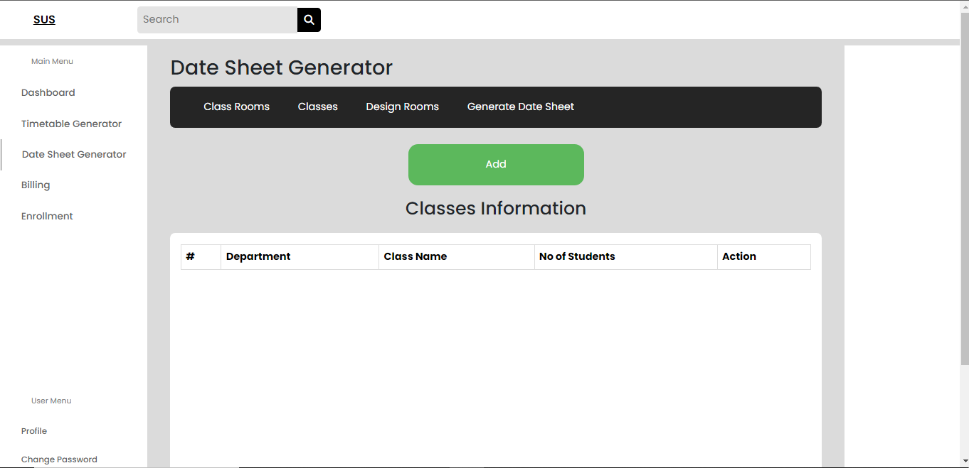
Date Sheet Generator Form
SUS(Smart University System)

Slide 18
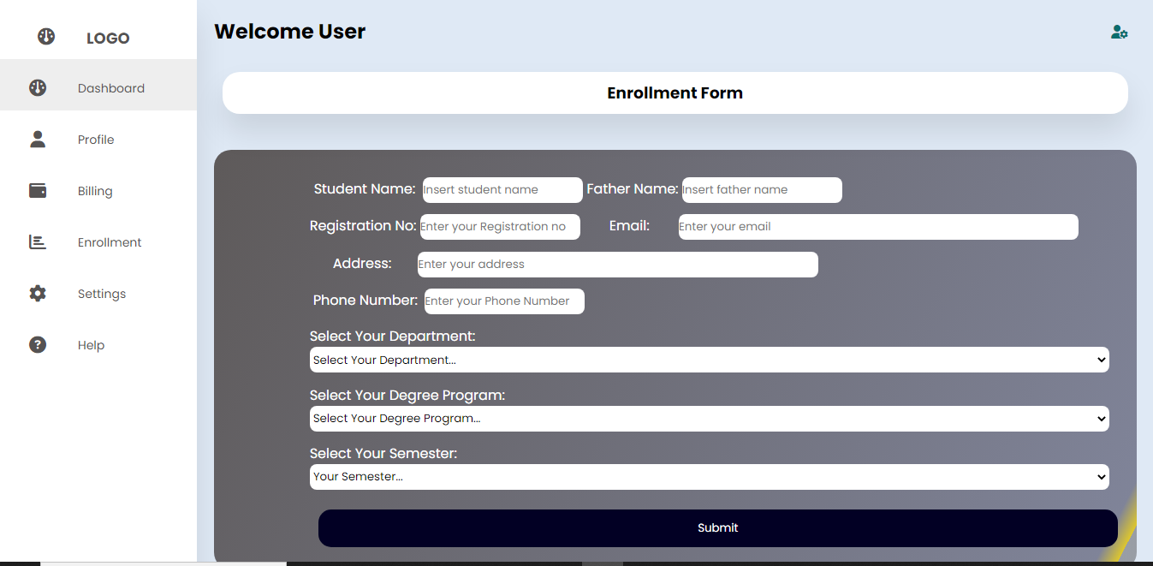
Student Enrollment Form
SUS(Smart University System)

Slide 19
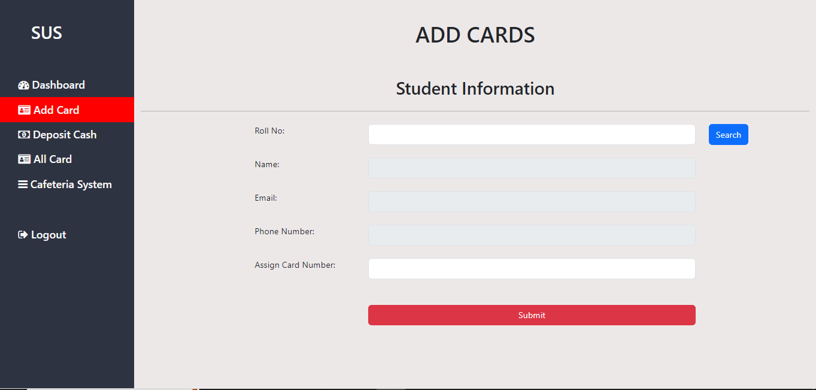
Billing System: ADD CARDS
SUS(Smart University System)

Slide 20
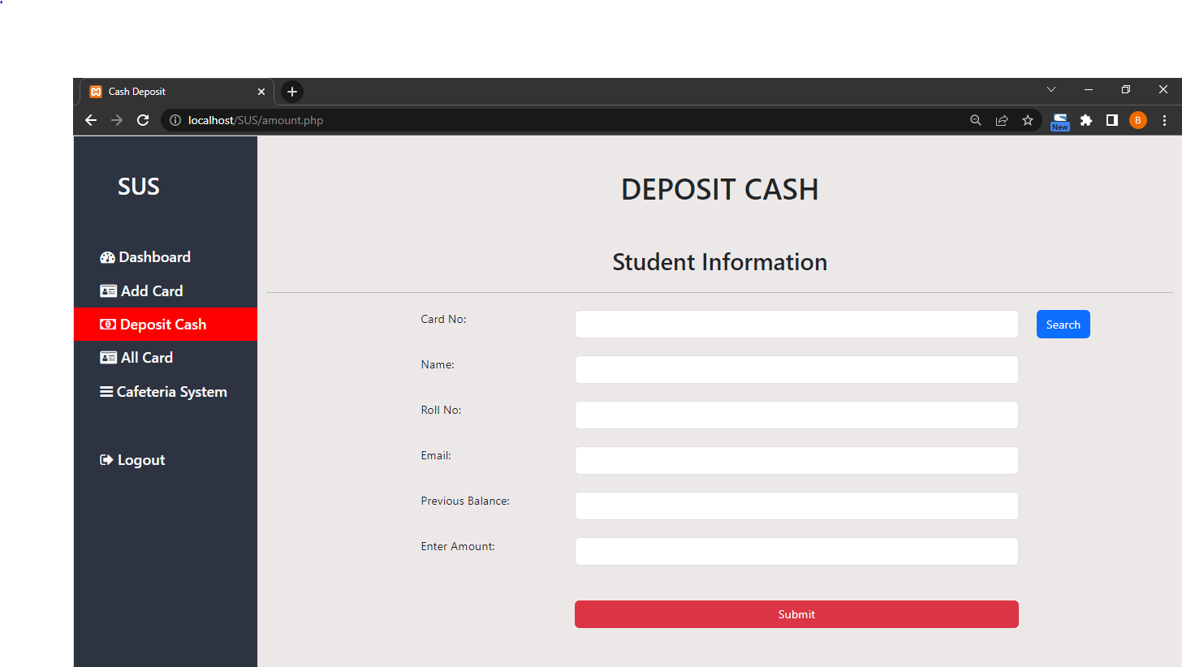
Billing System: DEPOSIT CASH
SUS(Smart University System)

Slide 21
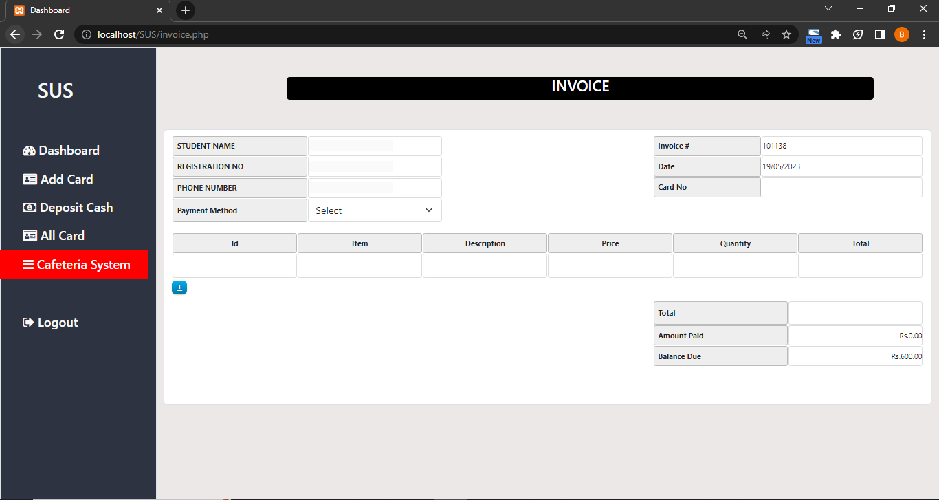
Billing System
SUS(Smart University System)

Slide 22
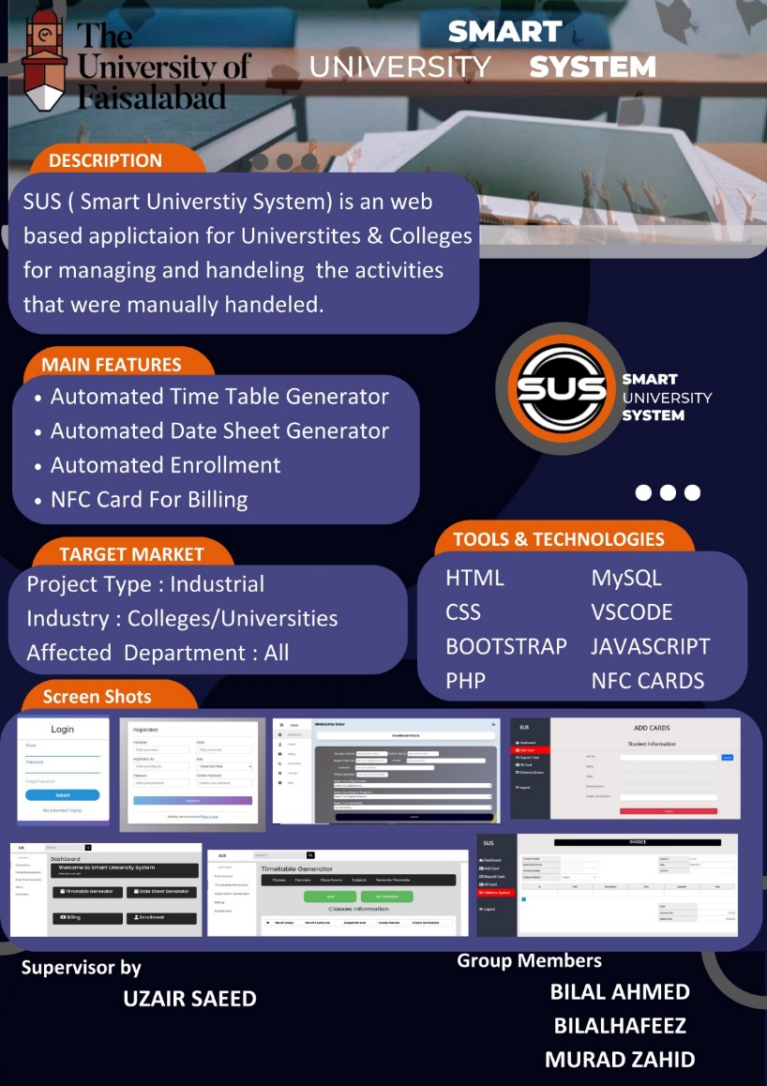
Poster of SUS
SUS(Smart University System)

Slide 23
Thanks for
listening
ANY QUESTION?

